Slide 1
Running Total
Dr. Anas Dahabiah

Slide 2
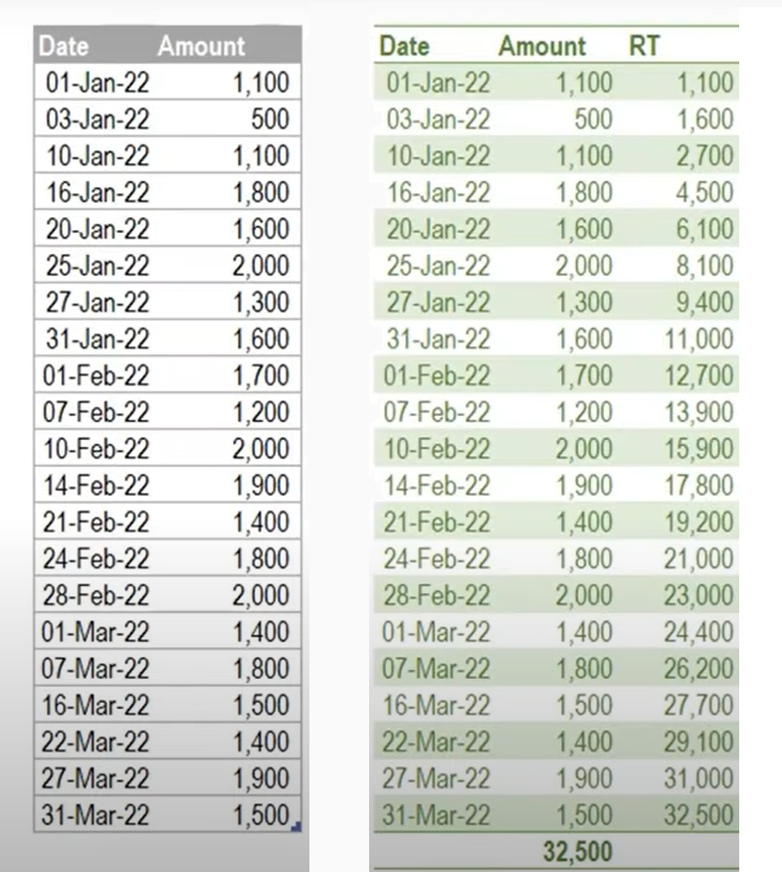

Slide 3
List.Sum(List.FirstN(#"Added Index"[Amount],[Index]))

Slide 4
List.Sum(List.FirstN(#"Added Index"[Amount],[Index]))

Slide 5
List.Sum(List.FirstN(#"Added Index"[Amount],[Index]))

Slide 6
List.Sum(List.FirstN(#"Added Index"[Amount],[Index]))

Slide 7
List.Sum(List.FirstN(#"Added Index"[Amount],[Index]))

