Slide 1



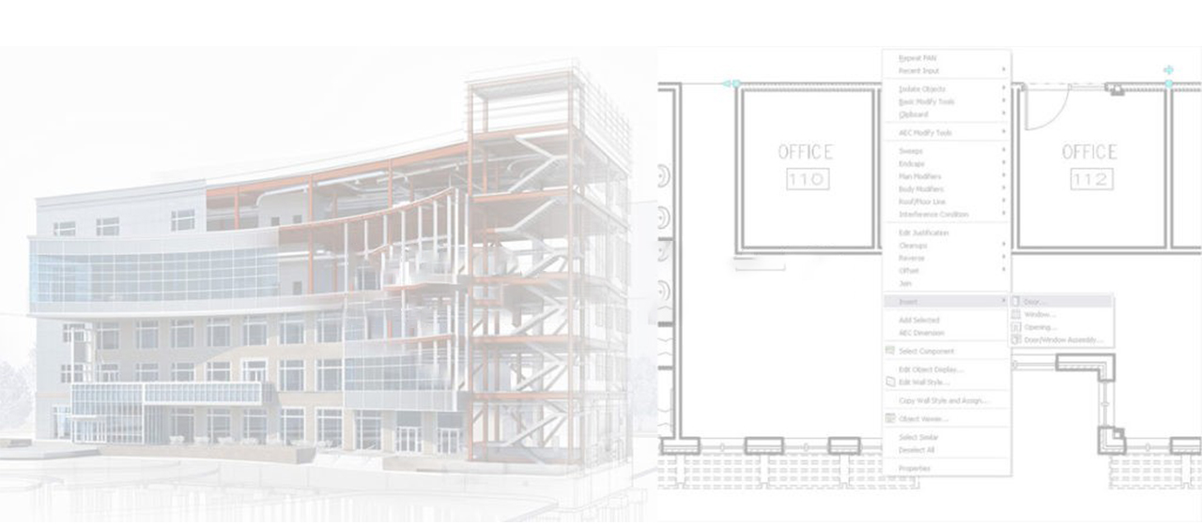
قائد نمذجة معلومات البناء
BIM Leader Diploma

Slide 2
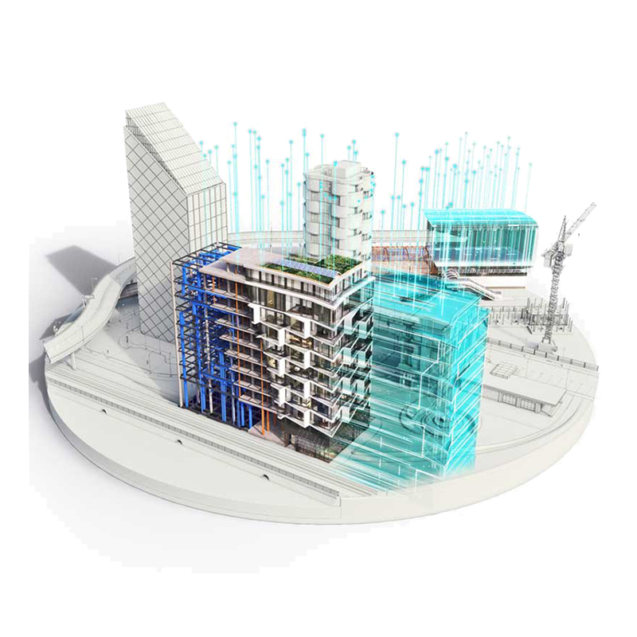
قائد نمذجة معلومات البناء
BIM Leader Diploma
إدارة البيانات والمعلومات الرقمية
2

Slide 3
قائد نمذجة معلومات البناء
BIM Leader Diploma
1
إدارة البيانات والمعلومات الرقمية
BIM Workflow
CDE
2
محتويات الوحدة
3
Open BIM (IFC-COBIE)
4
PM– Clash Detection
3

Slide 4






BIM WORKFLOW & DEFINITIONS
BIM Model
BIM Workflow
Level of Development
Contractual Documents (EIR – BEP and Appendices )
CDE
BIM Standards
Open BIM (IFC - BCF)
COBie

Slide 5
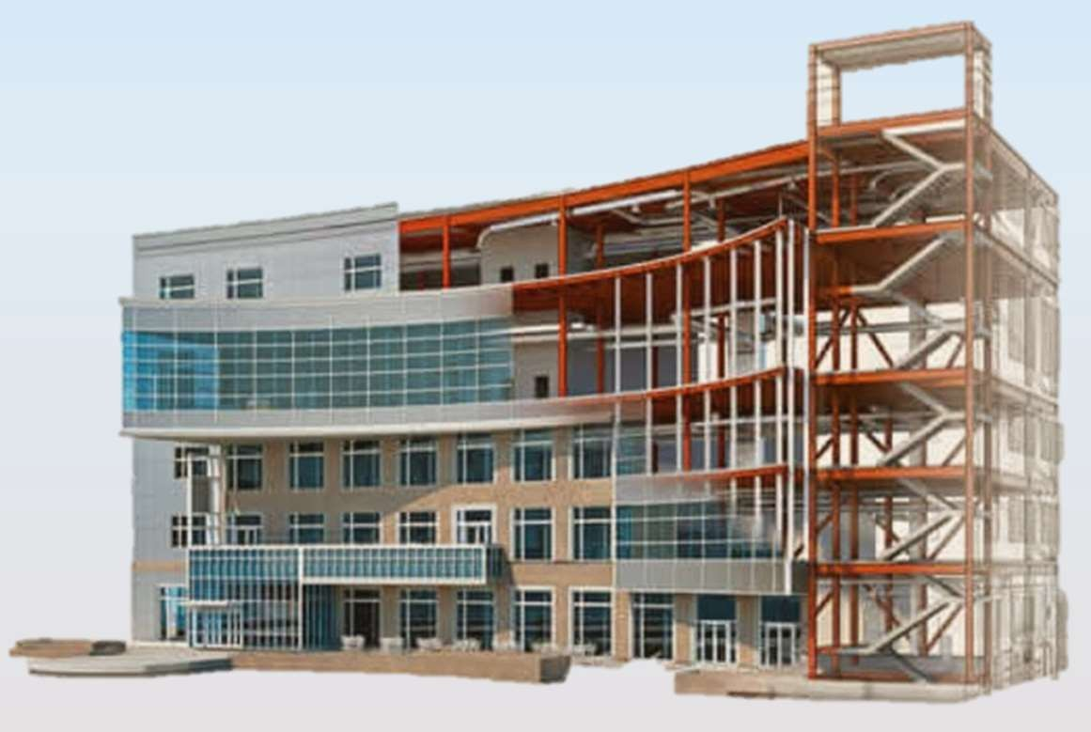
BIM MODEL
BIM Model= Information Model = Several Information Containers

Slide 6
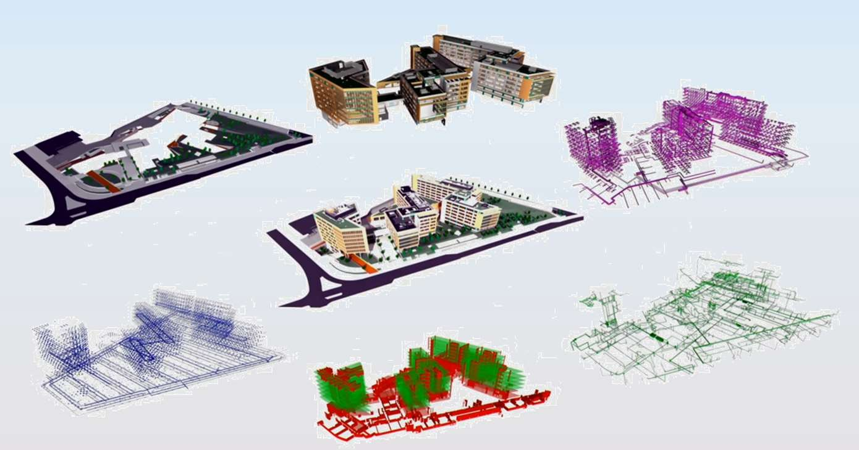
BIM MODEL
Federated Model = Several Information Containers

Slide 7
REQUIREMENTS & STANDARDS
Requirements
Information
Standards

Slide 8
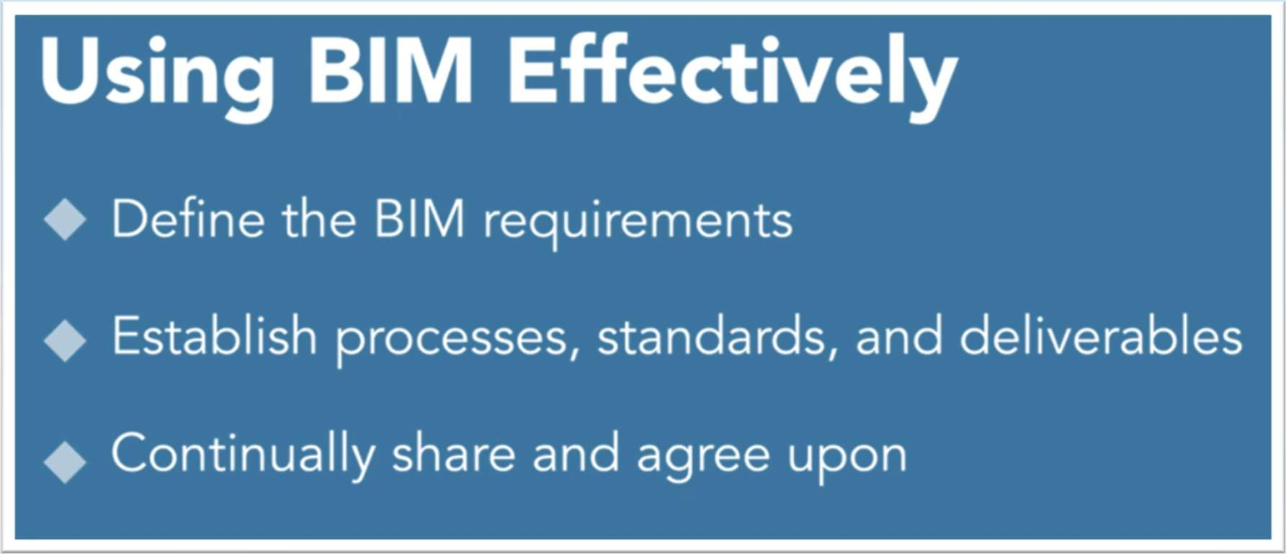
BIM WORKFLOW

Slide 9
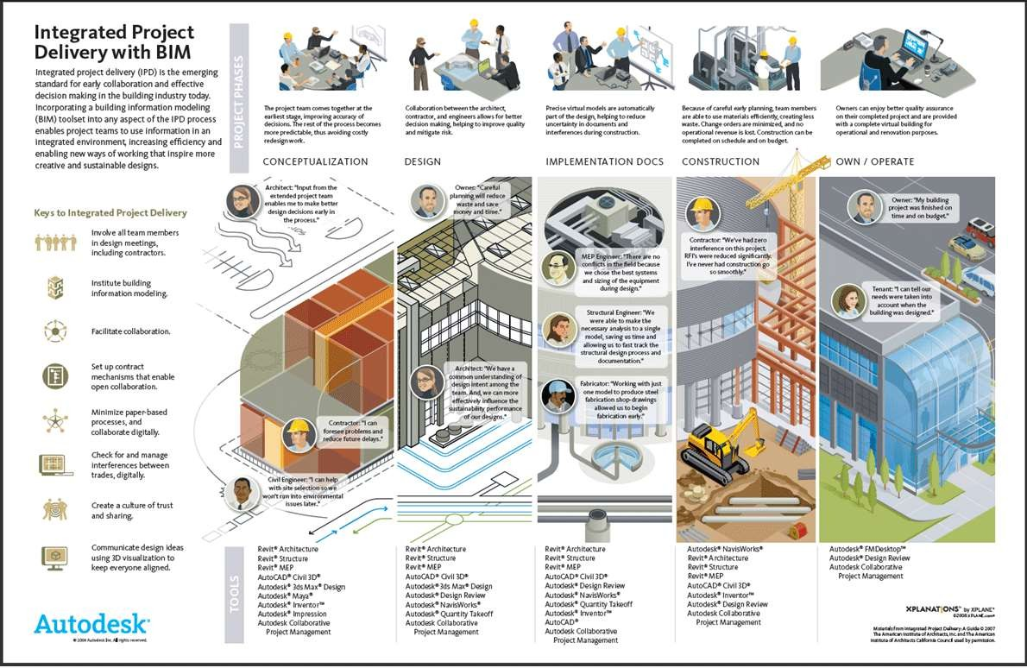

Slide 10
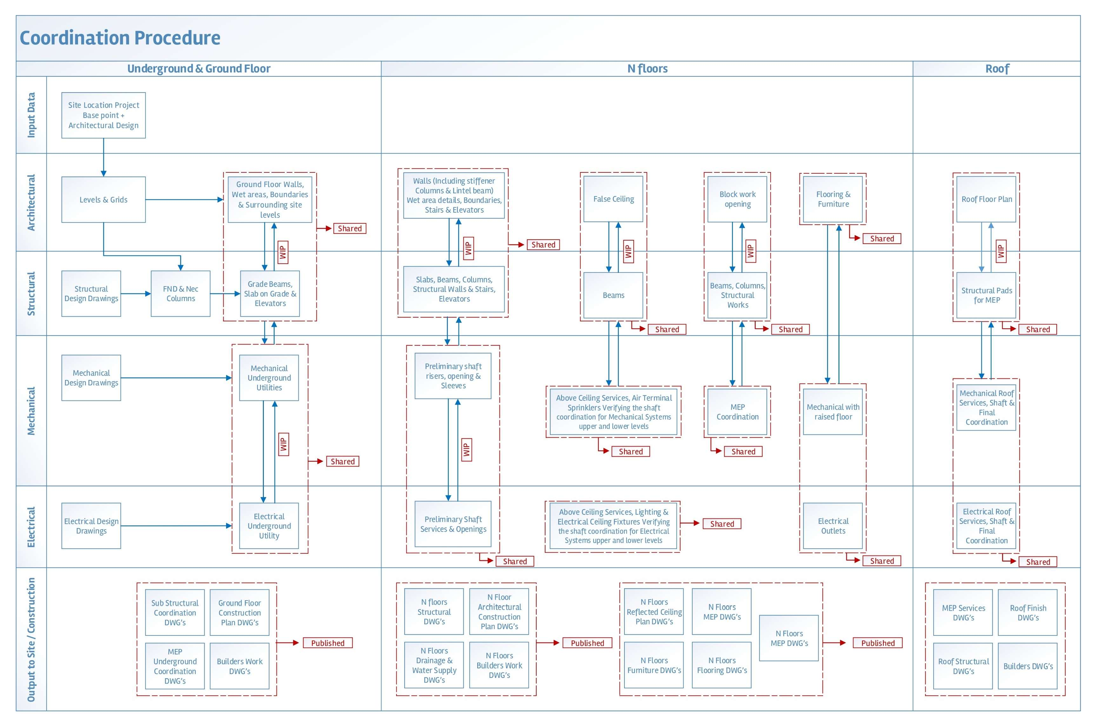
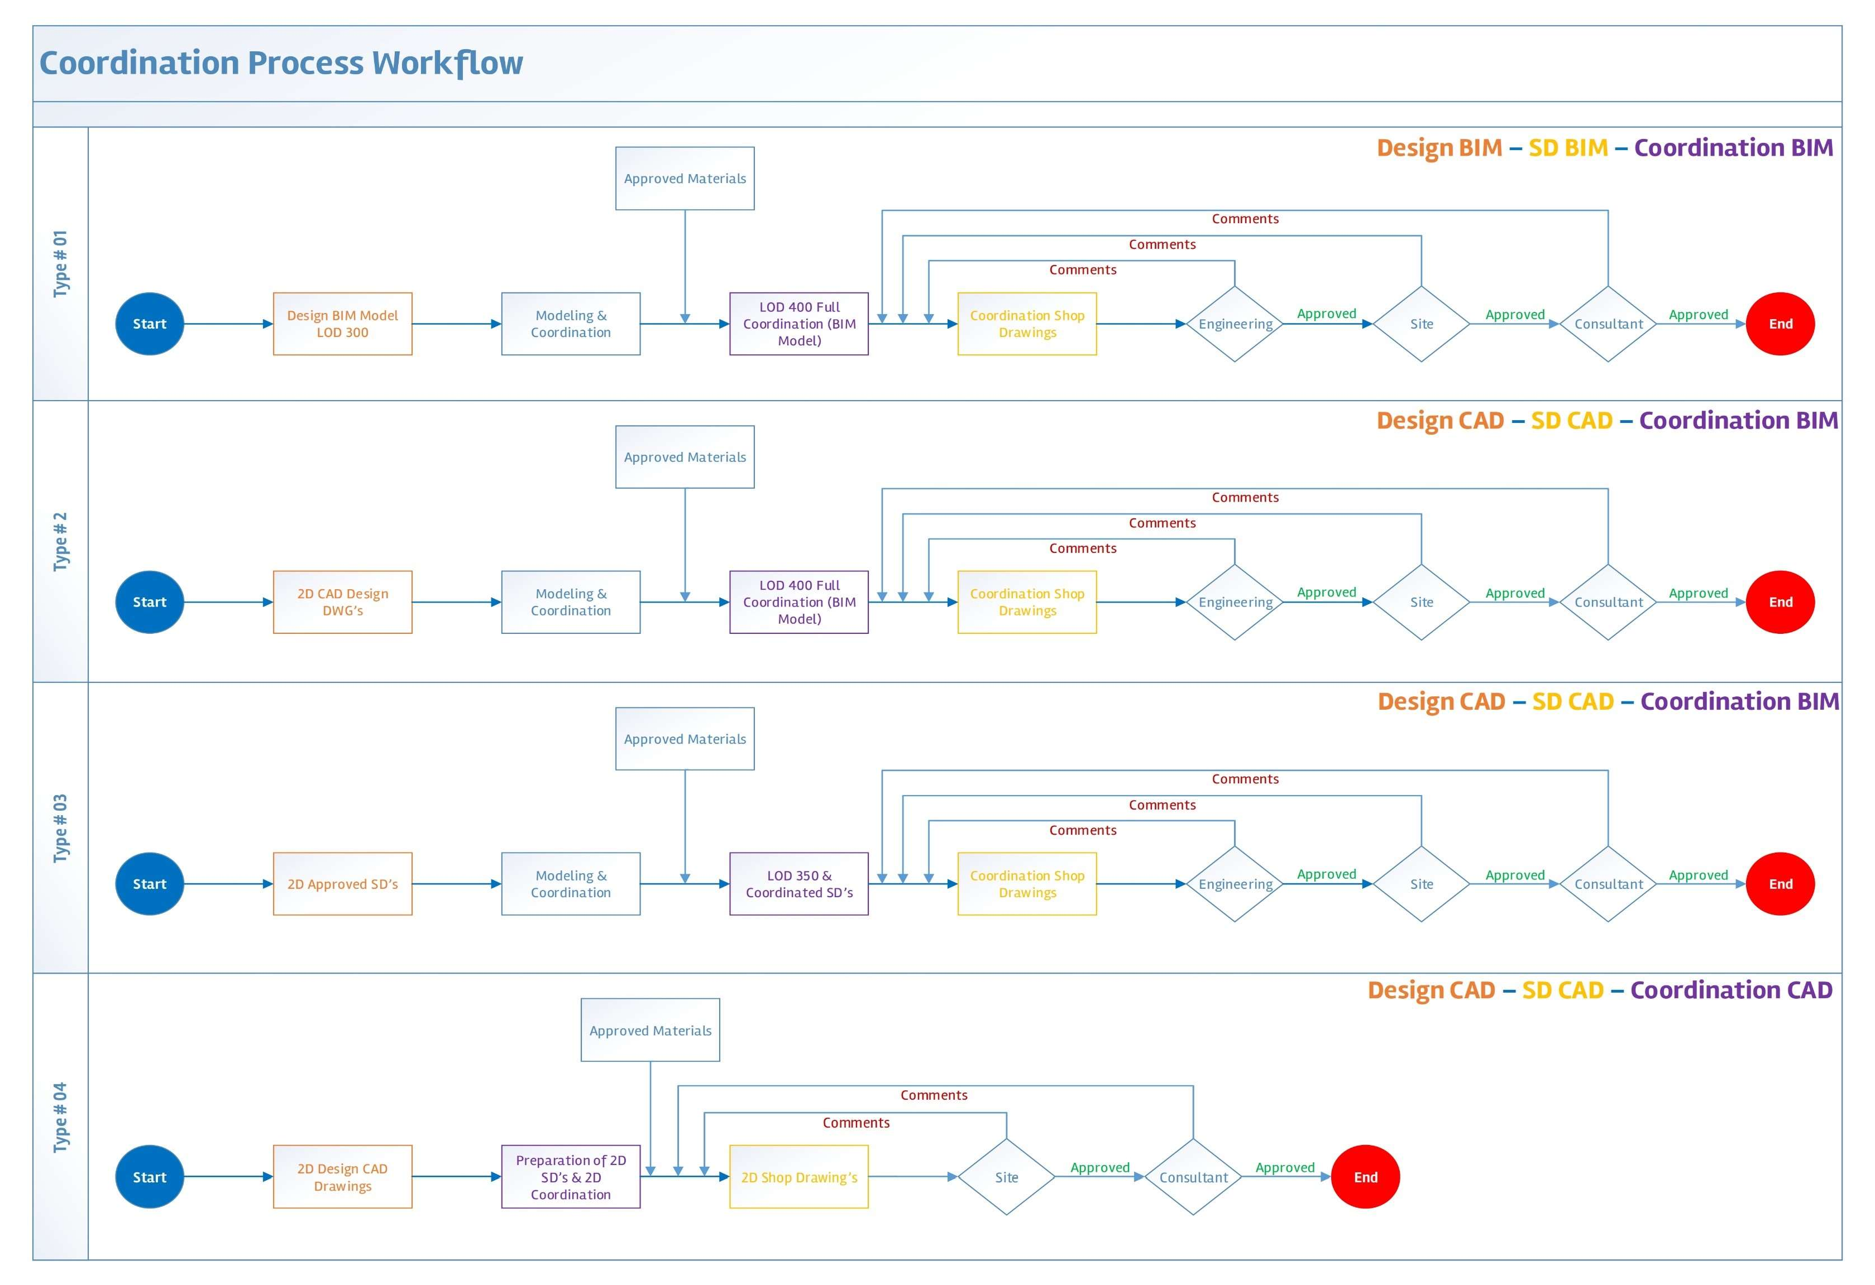
MODELING PROCEDURE

Slide 11
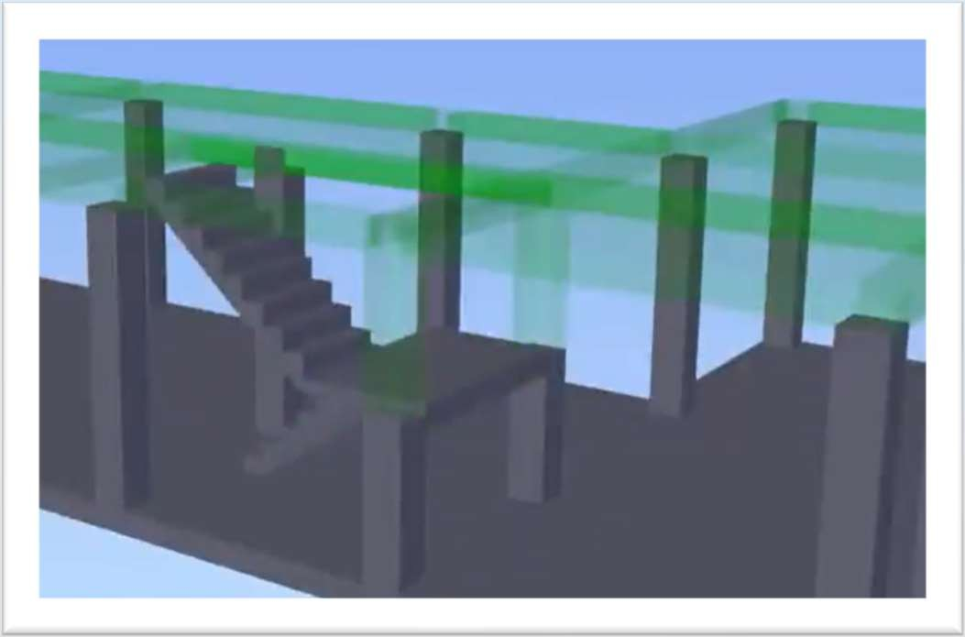
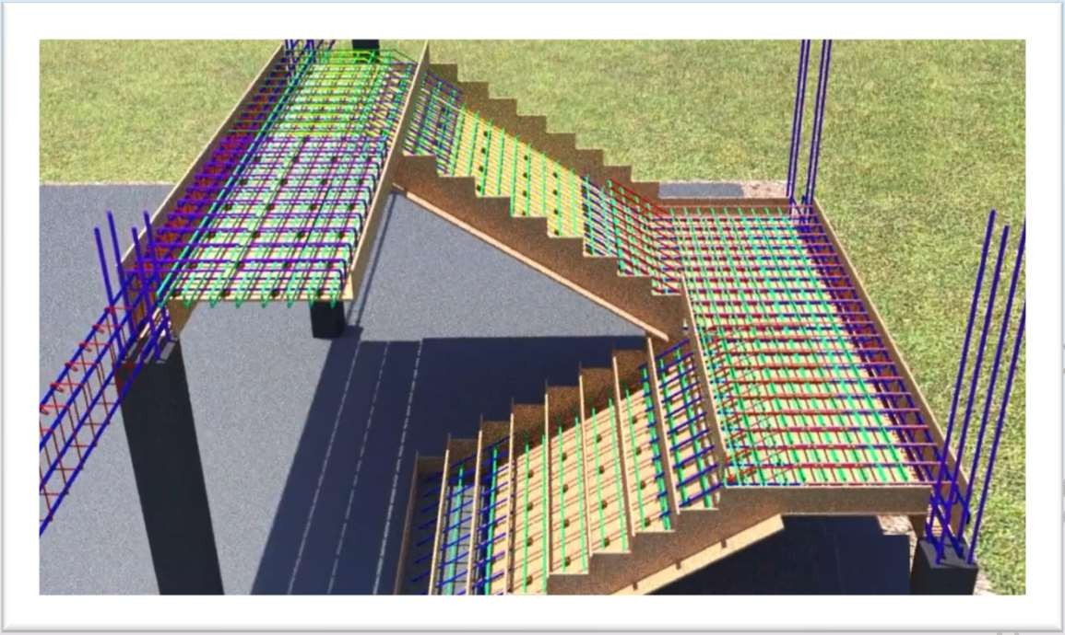
LEVEL OF DEVELOPMENT
Simulation of stairs

Slide 12
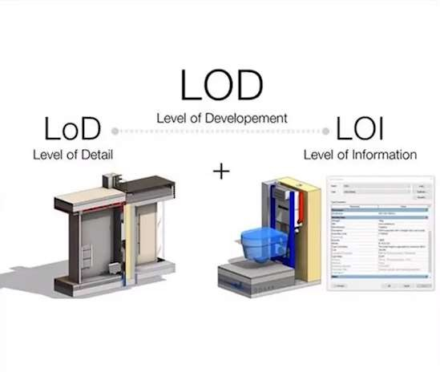
LEVEL OF DEVELOPMENT
Level of Development
Level of detail
Level of information
Level of Detail can be thought of as input to the element, while Level of Development is reliable output

Slide 13
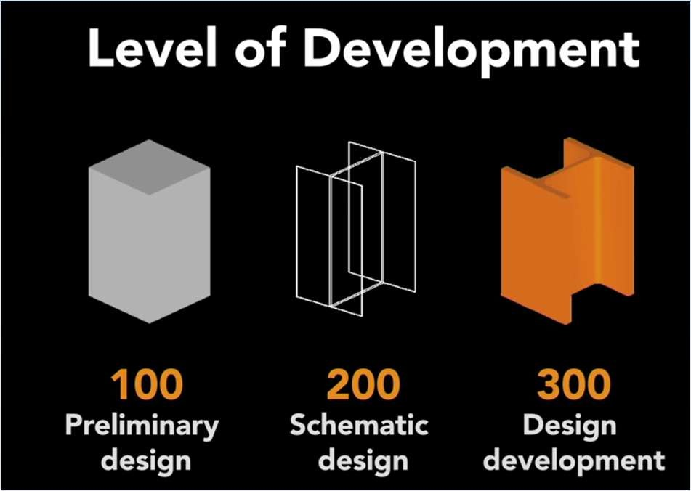
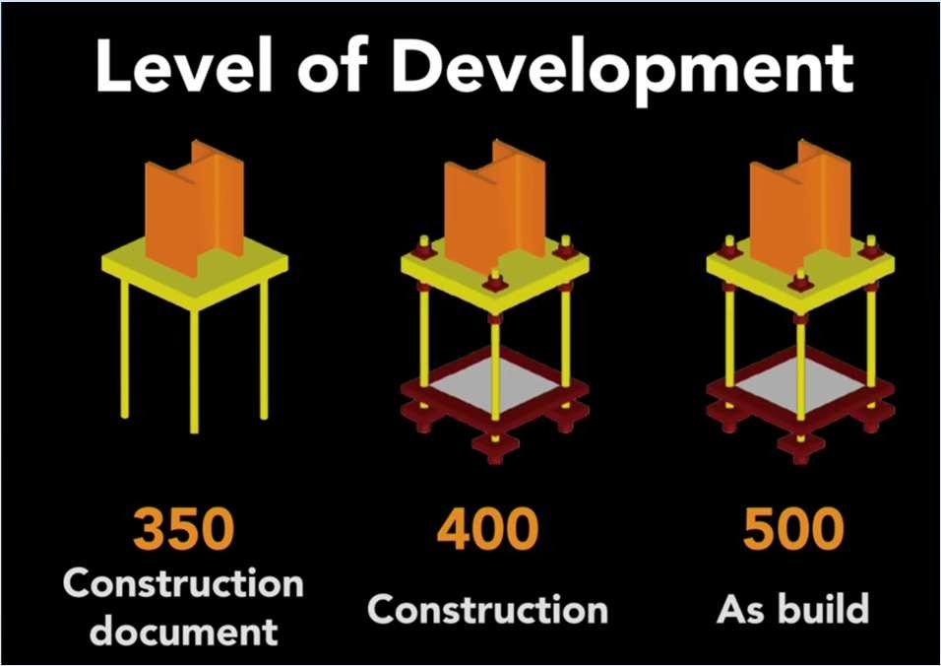
LEVEL OF DEVELOPMENT
LOD Spec 2021 Part I - FINAL 2021-12-28.pdf

Slide 14
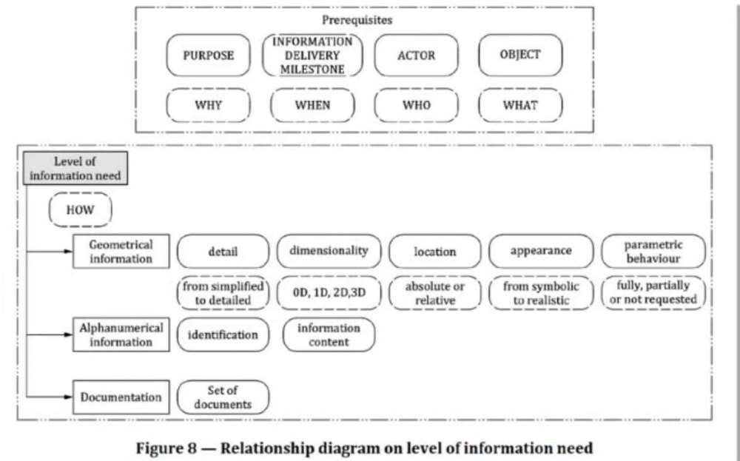
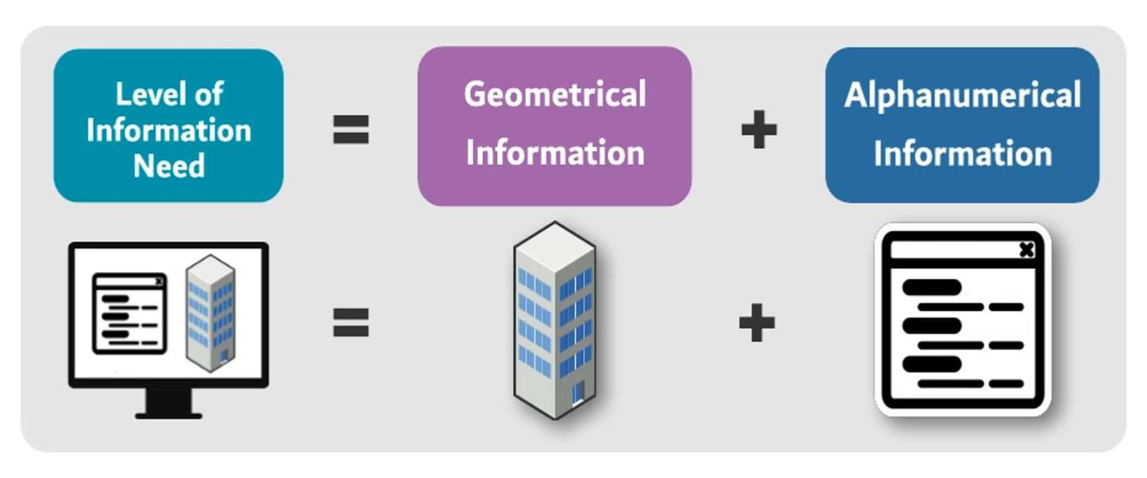
LEVEL OF INFORMATION NEED
ISO19650 interduces
level of information need (EN 17412-
1:2020) -
It is all about purpose
Source: EN 17412-1:2020

Slide 15
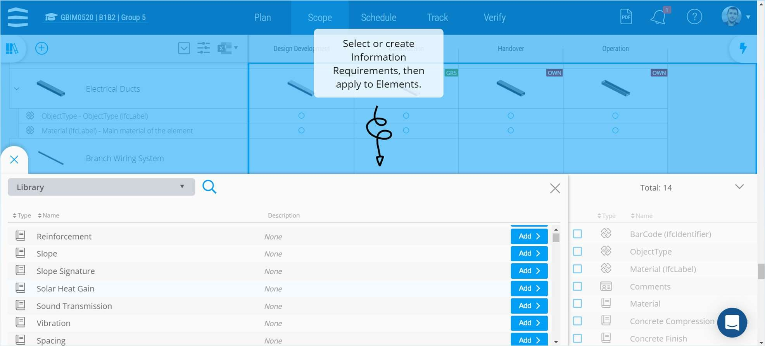
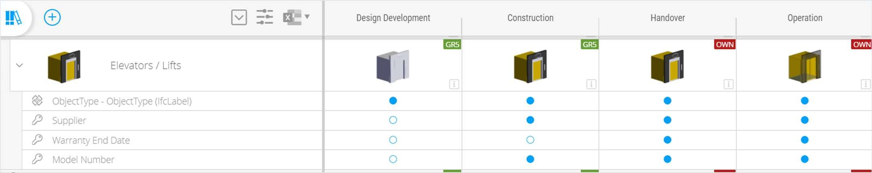
https://youtu.be/pCXTTxQgyx4?si=fgUFgfbzlkKzX9fX

Slide 16



CONTRACTUAL DOCUMENTS (EIR – BEP & APPENDICES )
EIR
BEP
EIR & BEP Relationship

Slide 17
EIR
It could be called
Employer Information Requirements
Exchange Information Requirements
Client BIM Protocol
Client BIM Requirements

Slide 18
EIR
BIM Uses
Asset Information Requirements (AIR)
Modeling Strategy and Data Segregation
Naming Conventions
Security Requirements

Slide 19
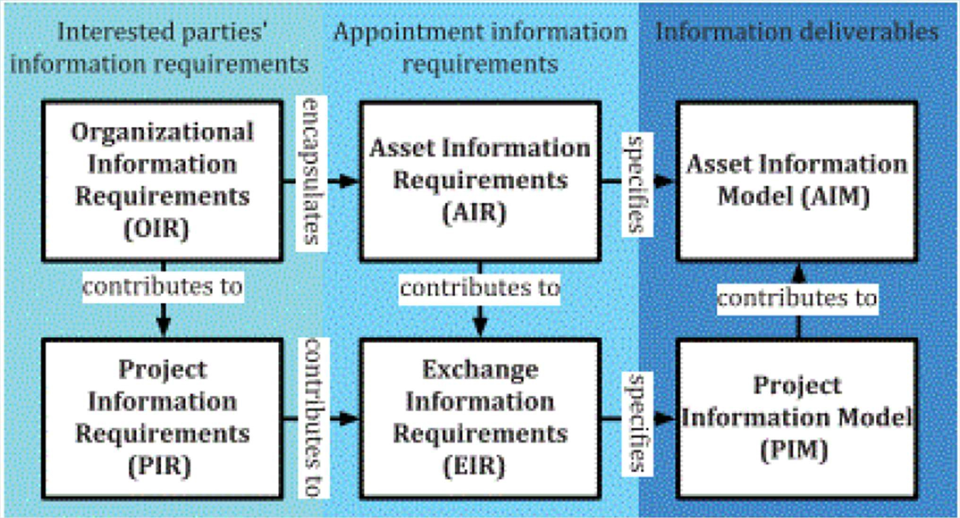

Slide 20
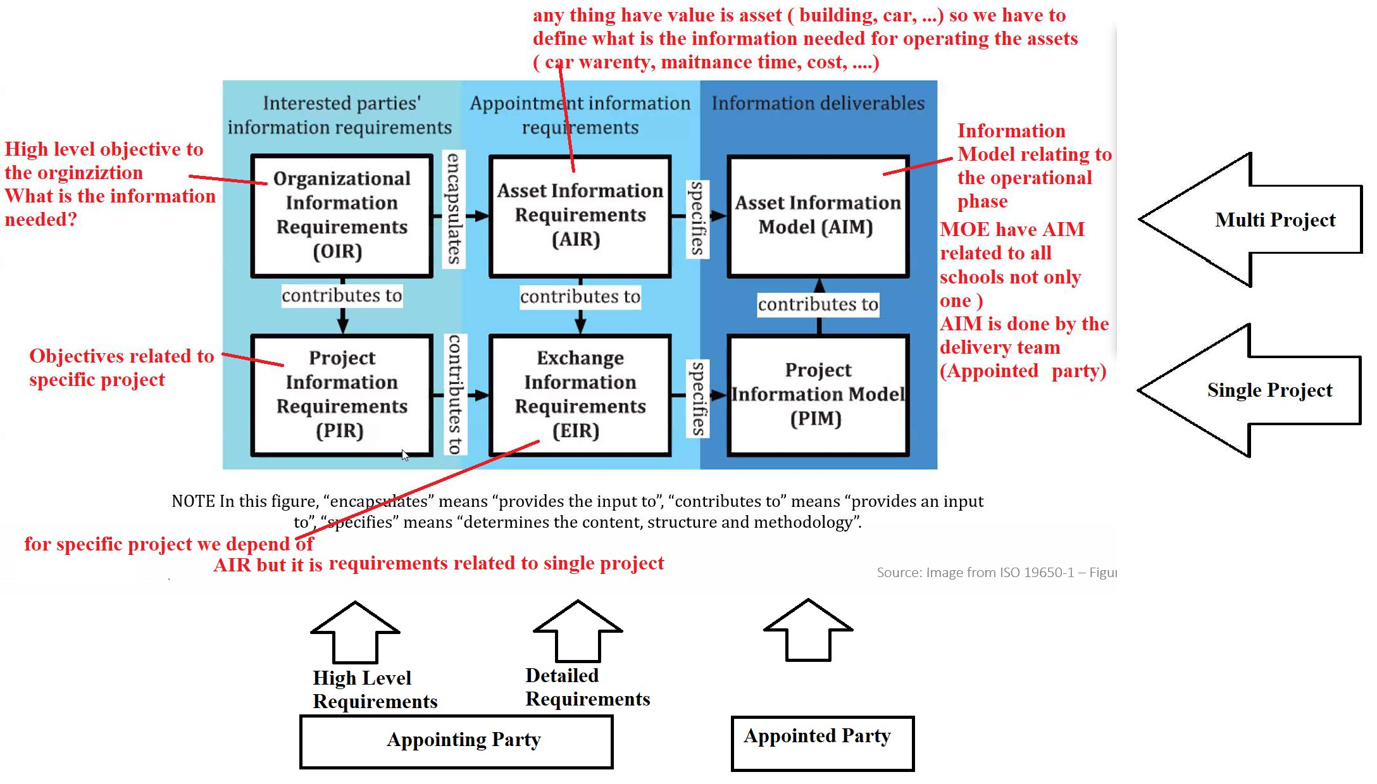

Slide 21
BIM EXECUTION PLAN (BEP)
How will the appointed party execute? The Plan to deliver BIM as per the EIR

Slide 22
BIM EXECUTION PLAN (BEP)
Project Information
References/Standards
BIM Team / Stakeholders
BIM Uses
MIDP
Federation Strategy
LOIN
Clash Matrix
Naming Convention
Software
Meetings
Shared Coordinates
Checking/Validation
QA/QC
BIM view Template

Slide 23
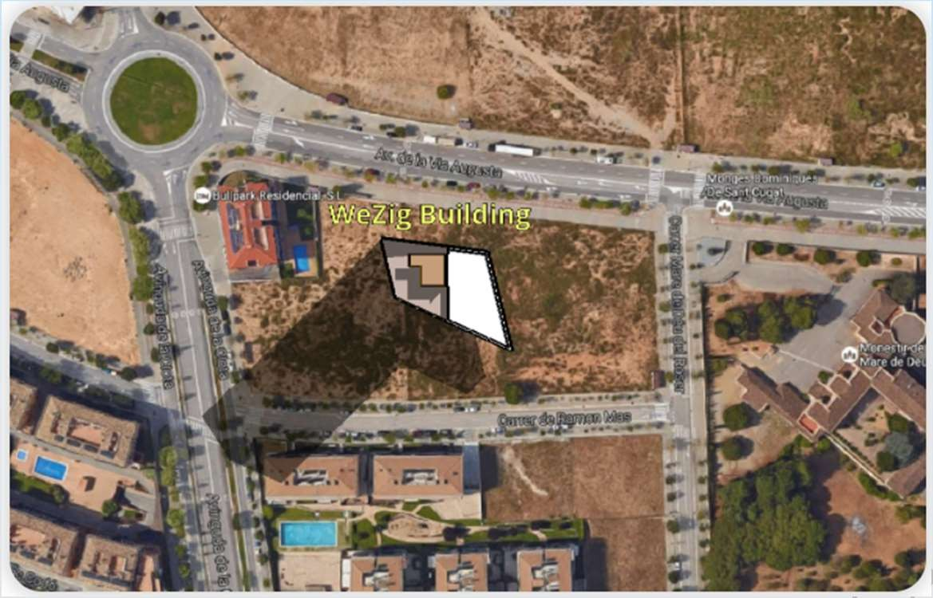
PROJECT INFORMATION
Project Information | Description
Project Owner: | Bonyan
Project Number | G05-002-2021
Project Name | Wezig Building
Work Type | Design
Contract Type | Lump Sum
Contract Number: | 002-2021
Other Project Information: | Wezig Building is a Mixed-use project building with one Basement and G+9 with a cantilevered first floor. Core structure with curtain wall facade envelope.
Location | Barcelona, Spain

Slide 24



























REFERENCES/STANDARDS
Standard | Usage M: Mandatory R: Recommended N/A: Not Applicable | Description | Discipline Use
ISO 19650-1:2018 | M | Organization and digitization of information about buildings and civil engineering works, including building information modeling (BIM) - Information management using building information modeling - Concepts and Principles | ARCH, STR, MEP
ISO 19650-2:2018 | M | Organization and digitization of information about buildings and civil engineering works, including building information modeling (BIM) - Information management using building information modeling - Delivery phase of the assets | ARCH, STR, MEP
BS 1192:2007 | M | Collaborative production of architectural, engineering, and construction information - Code of Practice | ARCH, STR, MEP
BS 1192-4:2014 | M | Collaborative production of information Part 4: Fulfilling Information Exchange using COBie - Code of Practice | ARCH, STR, MEP
BS 7000-4 | R | Managing construction and design | ARCH, STR, MEP
PAS 1192-3:2014 | M | Specification for information management for the operational phase of assets using building information modeling (BIM) | ARCH, STR, MEP
PAS 1192-5:2015 | M | Specification for security-minded building information modeling, digital built environments, and smart asset management | ARCH, STR, MEP
COBie (NBIMS US_V3_4.2) | M | Construction Operation Building Information Exchange | ARCH, STR, MEP
Uniclass 2015 | M | National Building Specification for Object Classification | ARCH, STR, MEP
ISO 5500:2014 | R | International Quality Standards | ARCH, STR, MEP
ISO BS EN 17412-1:2020 | M | Building Information Modelling. Level of Information Need. Concepts and principles | ARCH, STR, MEP

Slide 25



BIM TEAM / STAKEHOLDERS
Name | Role | Orgnizaton | Location
Xavier Coll | Owner + Client | Client | Barcelona, Spain
Ayman Mahran | Structural Manager | Design | KSA
Billel Dridi | MEP Manager | Design | UAE
Omar Nasrallah | Architectural Manager | Design | KSA
Ammar Saud | BIM Manager | PMC | KSA
Mohamed Ezzat | BIM Coordinator | Supervision | KSA
Ahmed Khalaf | MEP Manager | Supervision | KSA

Slide 26





BIM USES
BIM Goals | Description | Priority (High/Med/Low) | Plan/ Design/ Construct/ Operate
 |  |  | P | D | C | HO
Design Authoring | Providing the owner with powerful 3D visualization of the design with transparency ensures better collaboration and improves the quality control and quality assurance of the design, its cost, and schedule. | High | X | X | X | N/A
Design Reviews | Create different design options that meet the owner's needs and avoiding costly and timely traditional mock-ups. | High | N/A | X | X | N/A
3D Coordination | Coordinate the building project through a 3D model. To decrease construction time and cost, increase productivity, and get more accurate as-built drawings. | High | N/A | X | X
4D Phase Planning | Phase Planning | High | N/A | N/A | X | N/A
5D Cost Estimation | Provide the owner with a cost estimation schedule | Hight | X | X | X
Asset Management | Feed-in the Construction Operations Building Information Exchange(COBie) throughout the project life- cycle. Maintain up-to-date facility and equipment data including but not limited to maintenance schedules, warranties, cost data, upgrades, replacements, damages/deterioration, maintenance records, manufacturer's data, and equipment functionality. | Medium | N/A | X | X
Record Modeling | To provide the owner with an accurate and complete information model of the building, equipment, and spaces that can be useful for future renovation or equipment replacement. | High | N/A | N/A | N/A
Maintenance Scheduling | To effectively maintain building equipment through relying on preventive maintenance, avoiding costly corrective and emergency maintenance and improving the productivity of maintenance staff. | Medium | N/A | N/A | N/A | X

Slide 27


MIDP
Master Information Delivery Plan
All Deliverables List

Slide 28
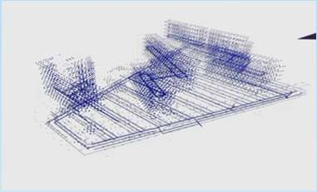
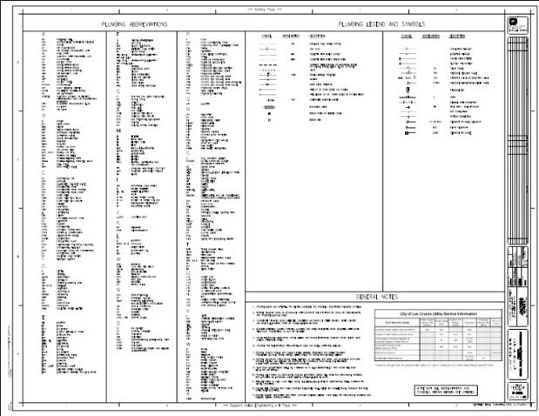
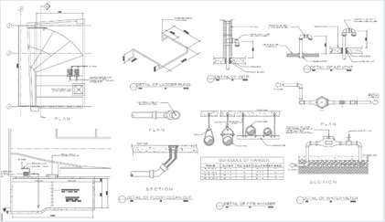
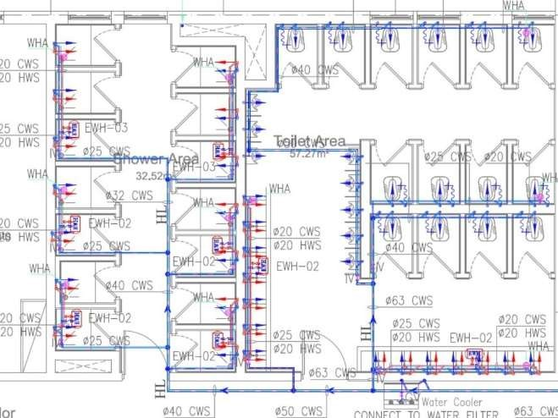
TASK INFORMATION DELIVERY PLAN (TIDP)
 |  |  |  |  |  |  | Refer to file naming convention doc for info
 |  |  |  |  |  |  | File Naming Conventions
DESCRIPTION | EXCHANGE FORMATS |  |  |  |  |  | Project Code | Contract Code | Originat or Code | Volume / System | Levels/ Location s | Docume nt Type | Disci pline | Series Number
 | RVT | NWC | IFC | DWG | PDF | NWD
PLUMBING MODEL | X | X | X |  |  |  | KS012 | 987 | BON | ABC | ZZ | MOD | PL | 00001
PLUMBING - NOTES, LEGEND AND ABBREVIATIONS |  |  |  | X | X |  | KS012 | 987 | BON | ABC | ZZ | DWG | PL | 00001
PLUMBING - TYPICAL DETAILS SHEET-1 |  |  |  | X | X |  | KS012 | 987 | BON | ABC | ZZ | DWG | PL | 00001
GROUND FLOOR WATER SUPPLY LAYOUT |  |  |  | X | X |  | KS012 | 987 | BON | ABC | GF | DWG | PL | 00001
LEVEL 01 WATER SUPPLY LAYOUT |  |  |  | X | X |  | KS012 | 987 | BON | ABC | 01 | DWG | PL | 00001
LEVEL 02 WATER SUPPLY LAYOUT |  |  |  | X | X |  | KS012 | 987 | BON | ABC | 02 | DWG | PL | 00001
ROOF WATER SUPPLY LAYOUT |  |  |  | X | X |  | KS012 | 987 | BON | ABC | RF | DWG | PL | 00001

Slide 29
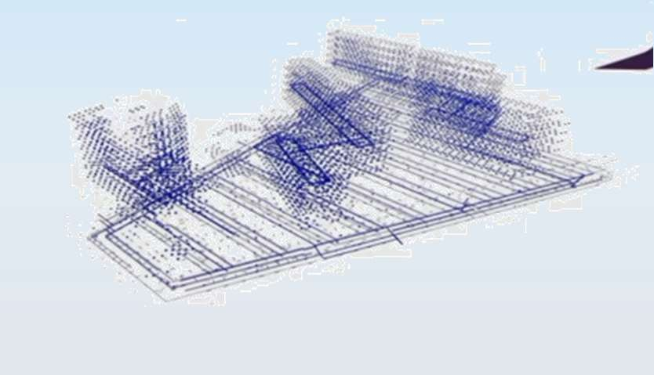
TASK INFORMATION DELIVERY PLAN (TIDP)
 |  |  |  |  |  |  | Refer to file naming convention doc for info |  |  |  |  |  |  |  | DATA EXCHANGE #01 |  | DATA EXCHANGE #02 |  | DATA EXCHANGE #03 |  | DATA EXCHANGE #04
 |  |  |  |  |  |  |  |  |  |  |  |  |  |  | STAGE: | Schematic Design | STAGE: | Schematic Design | STAGE: | Design Developme nt | STAGE: | Design Develop ment
 |  |  |  |  |  |  | File Naming Conventions
 |  |  |  |  |  |  |  |  |  |  |  |  |  |  | Milestone: | 50% Schematic Design | Milestone: | 100% Schematic Design | Milestone: | 50% Design Developme nt | Milestone: | 100% Design Develop ment
DESCRIPTION | EXCHANGE FORMATS |  |  |  |  |  | Project Code | Contrac t Code | Origina tor Code | Volum e/ System | Levels/ Locatio ns | Docum ent Type | Disci pline | Series Numbe r | Discipline | DATE REQUIRED TO ISSUE | Discipline | DATE REQUIRED TO ISSUE | Discipline | DATE REQUIRED TO ISSUE | Discipline | DATE REQUIRE D TO ISSUE
 | RVT | NW C | IFC | DW G | PDF | NW D
PLUMBING MODEL | X | X | X |  |  |  | KS012 | 987 | BON | ABC | ZZ | MOD | PL | 00001 | Mechanical Engineer | 1-Sep- 2022 | Mechanical Engineer | 16-Sep- 2022 | Mechanical Engineer | 1-Oct-2022 | Mechanical Engineer | 16-Oct- 2022
PLUMBING - NOTES, LEGEND AND ABBREVIATIONS |  |  |  | X | X |  | KS012 | 987 | BON | ABC | ZZ | DWG | PL | 00001 | Mechanical Engineer | 1-Sep- 2022 | Mechanical Engineer | 16-Sep- 2022 | Mechanical Engineer | 1-Oct-2022 | Mechanical Engineer | 16-Oct- 2022
PLUMBING - TYPICAL DETAILS SHEET-1 |  |  |  | X | X |  | KS012 | 987 | BON | ABC | ZZ | DWG | PL | 00001 | Mechanical Engineer | 1-Sep- 2022 | Mechanical Engineer | 16-Sep- 2022 | Mechanical Engineer | 1-Oct-2022 | Mechanical Engineer | 16-Oct- 2022
GROUND FLOOR WATER SUPPLY LAYOUT |  |  |  | X | X |  | KS012 | 987 | BON | ABC | GF | DWG | PL | 00001 | Mechanical Engineer | 1-Sep- 2022 | Mechanical Engineer | 16-Sep- 2022 | Mechanical Engineer | 1-Oct-2022 | Mechanical Engineer | 16-Oct- 2022
LEVEL 01 WATER SUPPLY LAYOUT |  |  |  | X | X |  | KS012 | 987 | BON | ABC | 01 | DWG | PL | 00001 | Mechanical Engineer | 1-Sep- 2022 | Mechanical Engineer | 16-Sep- 2022 | Mechanical Engineer | 1-Oct-2022 | Mechanical Engineer | 16-Oct- 2022
LEVEL 02 WATER SUPPLY LAYOUT |  |  |  | X | X |  | KS012 | 987 | BON | ABC | 02 | DWG | PL | 00001 | Mechanical Engineer | 1-Sep- 2022 | Mechanical Engineer | 16-Sep- 2022 | Mechanical Engineer | 1-Oct-2022 | Mechanical Engineer | 16-Oct- 2022
ROOF WATER SUPPLY LAYOUT |  |  |  | X | X |  | KS012 | 987 | BON | ABC | RF | DWG | PL | 00001 | Mechanical Engineer | 1-Sep- 2022 | Mechanical Engineer | 16-Sep- 2022 | Mechanical Engineer | 1-Oct-2022 | Mechanical Engineer | 16-Oct- 2022

Slide 30
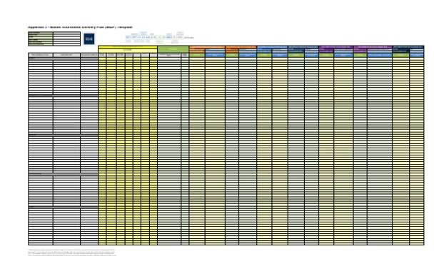

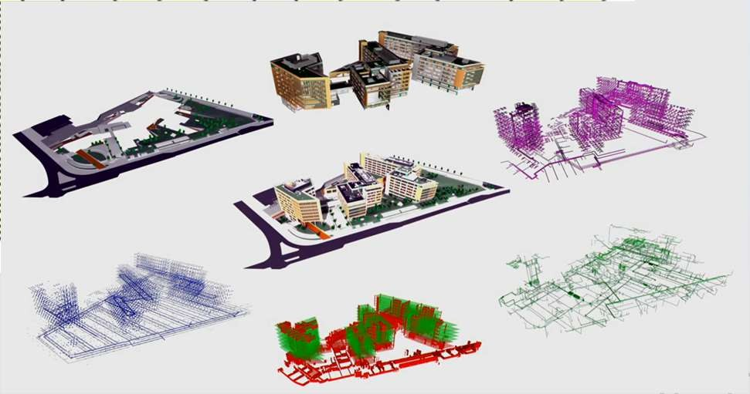
MASTER INFORMATION DELIVERY PLAN (MIDP)
TIDP ARC
TIDP STR
TIDP PLP
MIDP
TIDP MEC
TIDP ELE

Slide 31
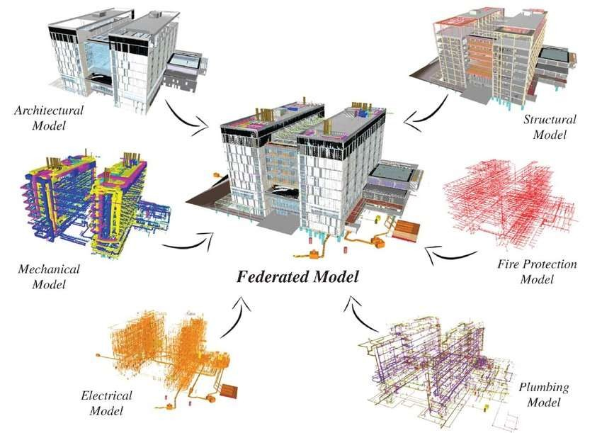
FEDERATION STRATEGY

Slide 32
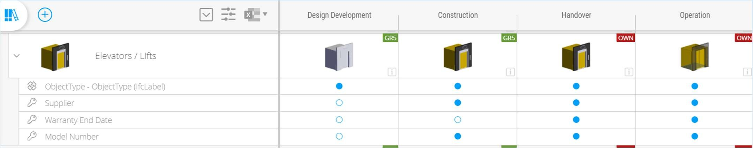
LOIN

Slide 33
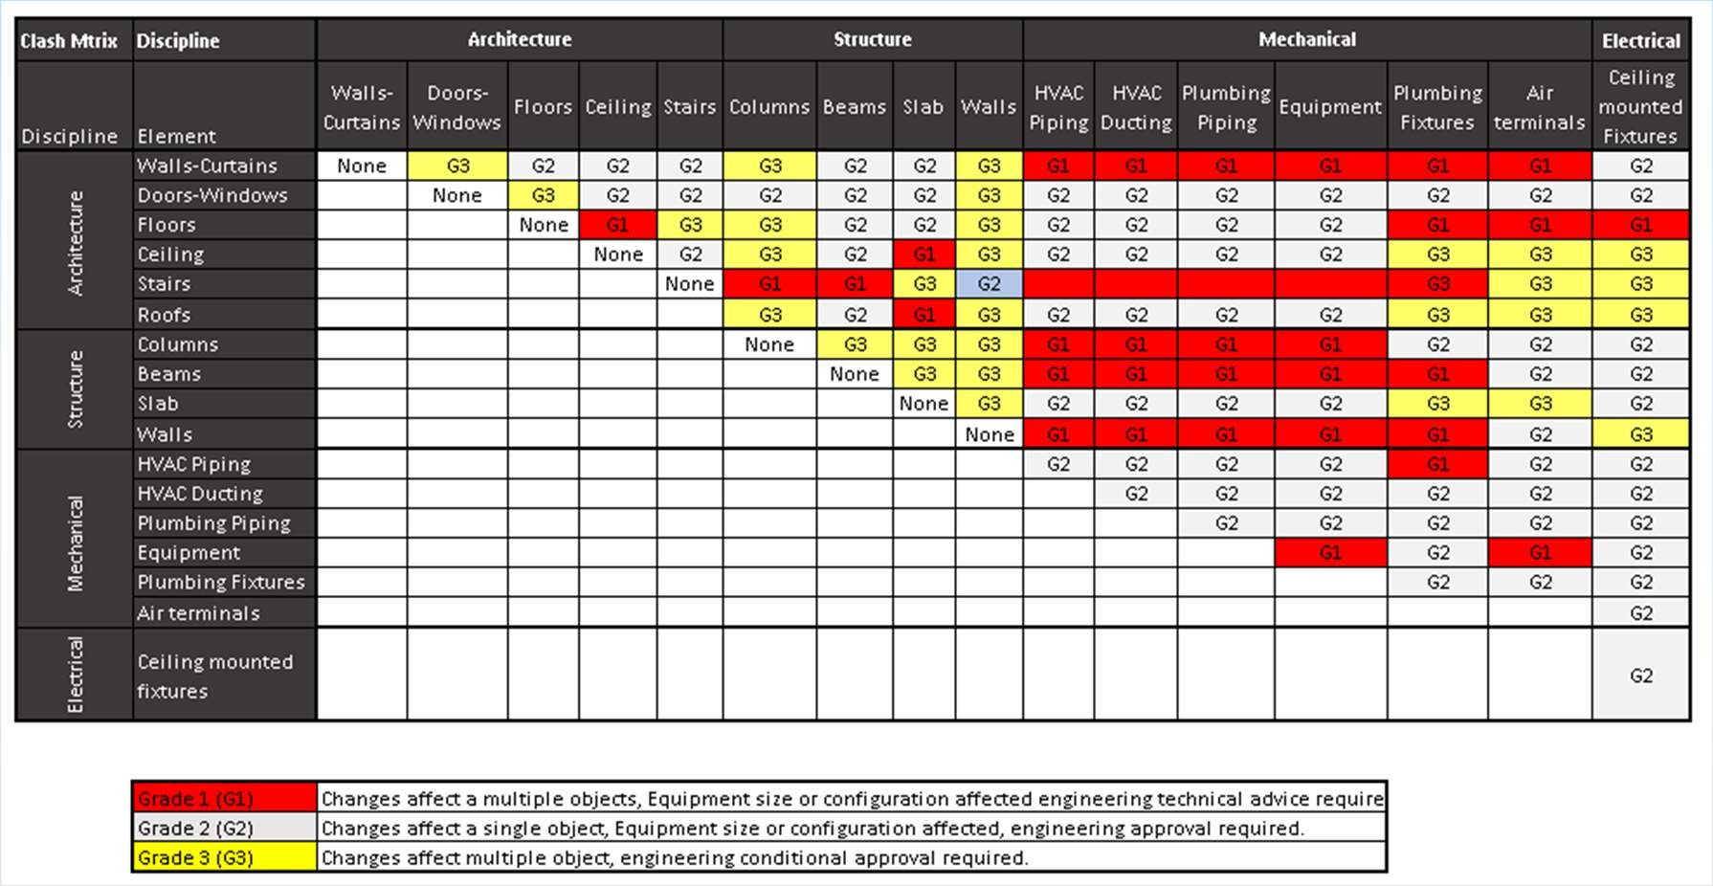
CLASH MATRIX

Slide 34
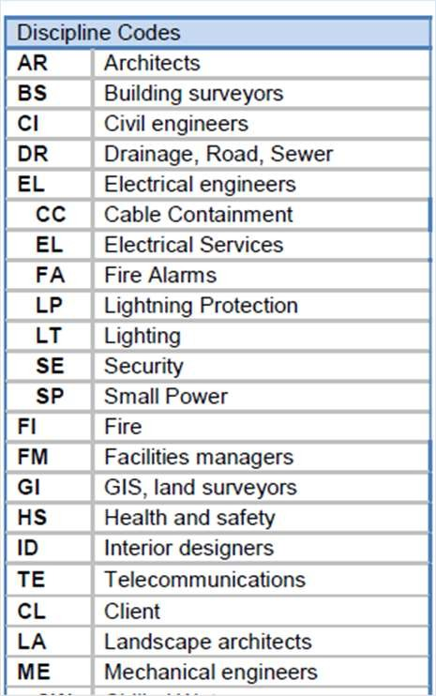
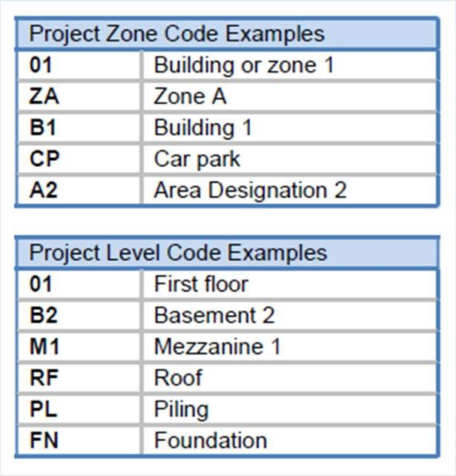
NAMING CONVENTION

Slide 35
SOFTWARE
Use | Authoring Tool / Platform | Version
BIM Management Platform | Plannerly | Web Service
Data Management, Information exchange | BIMsync / One Drive | Web Service
Design / Construction Documents (Architecture) | Graphisoft Archicad | 2024 / 25
Design / Construction Documents (Structure) | Autodesk Revit | 2024
Design / Construction Documents (Civil) | Autodesk Revit / Tekla structure | 2024
Design / Construction Documents (MEP) | Autodesk Revit | 2024
3D Coordination / Clash Detection / Issue Management | BIMSync, BIMCollab Zoom, Solibiri | 2024
QTO | Solibiri | 2024
Model Validation | Solibiri ,BIMCollab Zoom | 2024
Cost Estimation | Solibiri, Excel | 2024
Site Collaboration | DALUX FIELD | Web Service

Slide 36
MEETINGS
Meeting title | Description | Participants | Frequency | Location
Project Kick-off Meeting | Meeting to establish the principles of BIM adoption, scope, and ambition on the proposed project and to set up the post-contract-award BEP. Establish when and where future meetings will be held. | BIM manager BIM Coordinator MEP manager Architectural manager Structural manager | Single occurrence | Virtual
BIM workgroup meeting | Meeting to track the progress of BIM implementation on the project in the context of the BEP. This meeting should be used as a mechanism to identify forthcoming challenges and agree a proactive solution | BIM manager BIM Coordinator MEP manager Architectural manager Structural manager | Monthly | Virtual
BIM coordination meeting | Meeting to review and allocate responsibility to clashes found during the clash detection process undertaken | BIM manager BIM Coordinator MEP manager Architectural manager Structural manager | Weekly | Virtual
BIM validation meeting | Meeting to review and discuss deficiencies in model geometry and data identified during the model validation checks undertaken | BIM manager BIM Coordinator MEP manager Architectural manager Structural manager | Monthly–Aligned with BIM workgroup meetings | Virtual
BIM Use Progress Reviews | Metting to review and confirm BIM use progress aligned with project milestones. | BIM manager BIM Coordinator MEP manager Architectural manager Structural manager | Monthly / Weekly | Virtual
BIM Stage Closeout | Meeting to review and confirm project BIM deliverables according to EIR. | BIM manager BIM Coordinator MEP manager Architectural manager Structural manager | At Closeout Stage | Virtual

Slide 37
SHARED COORDINATES
Physical Project Coordinates:
Project rotation from true north | 8.44°
Unit of measurement | metric units
Project Basepoint | E/W : 21611.1382 | N/S : 8971.0100
Project Elevation from sea level | 110 m
Project Survey Point | E/W : 21596.700 | N/S : 8971.7 00

Slide 38
CHECKING/VALIDATION
Check that all families and worksets conform to standard naming conventions
Check that all objects are correctly classified in accordance with the BEP
Check that all objects contain the correct asset data appropriate to the design stage.
Check the file size should be checked according to the approved BEP
All extraneous drawing sheets, (i.e. those deemed to be not deliverable), have been removed from the BIM Model
Model external references (Xrefs) have been audited and purged
File format and naming conventions conforms to the EIR and remain constant for the lifespan of the project
Data segregation conforms to project requirements
3D and 2D drawings are up to date and that the 2D information has been derived from the model
All objects in a 3D default view must be made visible
All models to use the shared co-ordinate system defined at the outset of the project
Check the area and volume computations
Correct Grid and Level
Correct Model Category
Project Information is filled
Unused Linked cad Drawings to be removed
Check Project Base Point as per BEP

Slide 39
QA/QC
Check model filename conforms to the BEP
Ensure model is detached from "Central" and audited while submitting on ACONEX
Update the model splash screen with correct revision and status etc.
Unload all links (do not remove the link)
Purge model (repeat process at least 3)
Check model is correctly assembled through visual inspection
Remove all non-required Views/Legends/Schedules/Sheets/Images
Check that all content is in the correct workset
Review and fix all warning messages where possible
Save model as next revision to CDE
Check & remove Object duplications
No in-place modelled families in the project
No 3D lines representing geometry should present in the model
Project points (survey and base points) should be checked according to the approved BEP
No filled region is used in drawing preparation to hide true model geometry
No design option should be used
Check model against floating elements, connectivity issues.
Visual appearance- no overlapping model element should present in the model

Slide 40
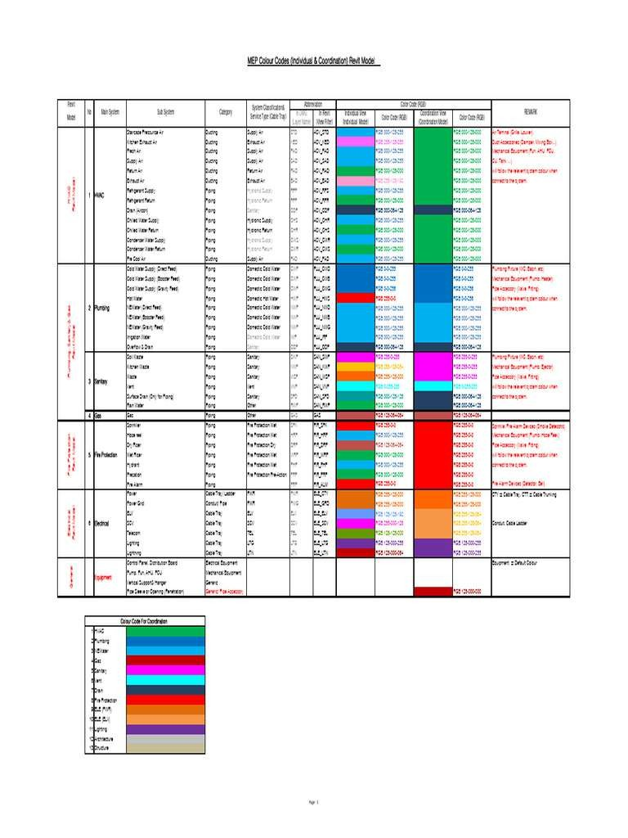
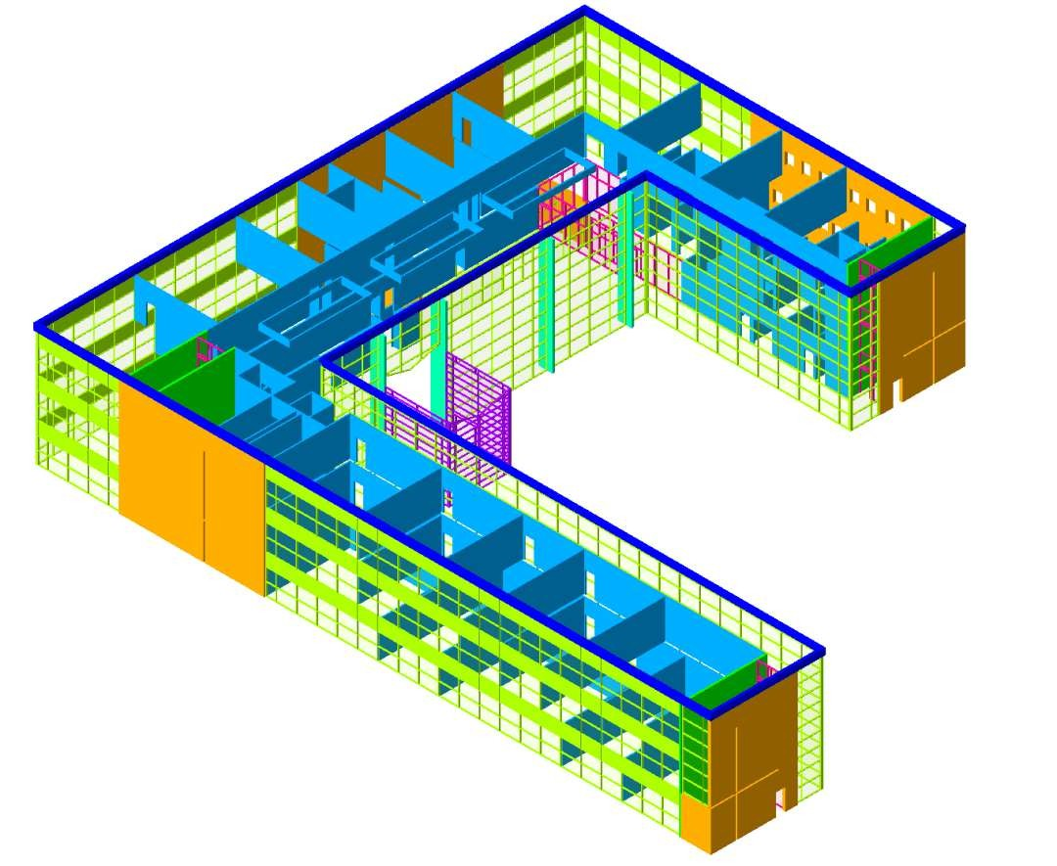
BIM VIEW TEMPLATE

Slide 41





INFORMATION REQUIREMENT
Client
Contractor
Contractor
More details
More details
Sub Contractor
Sub Contractor

Slide 42
INFORMATION REQUIREMENT
Client
Contractor
Contractor
More details
More details
Sub Contractor
Sub Contractor

Slide 43
INFORMATION REQUIREMENT
Appointing Party
Lead Appointed Party
Lead Appointed Party
More details
More details
Appointed Party
Appointed Party

Slide 44
BEP
Sometimes it is required to submit pre-BEP in the bidding phase
Sometimes it is required to fill BIM assessment form
BEP is a live document (always Code B not A)

Slide 45
BEP
For your reference:
cpix_post_contract_bim_execution_plan_bep_r1.0
cpix_pre-contract_bim_execution_plan_bep_v2.0
cpix_-_bim_assessment_form_ver_1.0

Slide 46
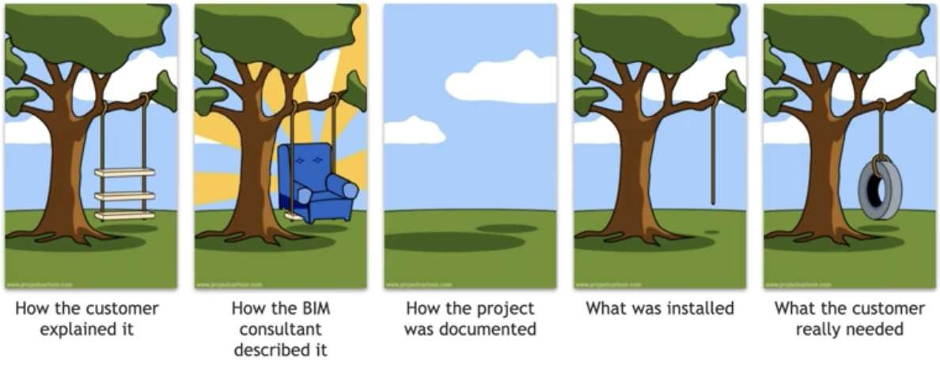

Slide 47
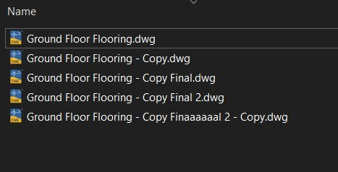


CDE
Dear Ahmad
Please send me the last approved flooring drawings for ground floor
Dear Sami
Please find the attached file as
requested.
Best Regard
Best Regard
Dear Sami
Dear Sami
Please find the attached new version of flooring drawings
Please find the attached new revision of flooring drawings
Best Regard
Best Regard

Slide 48
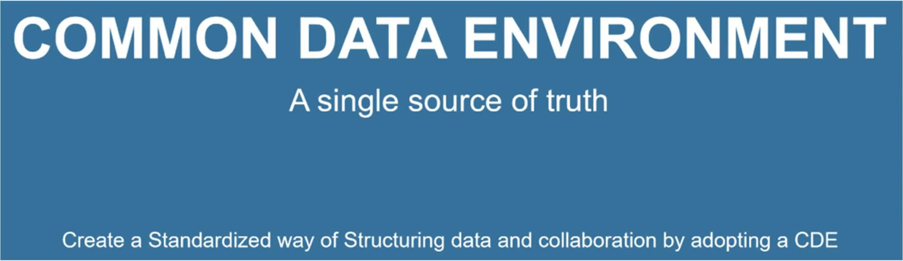
CDE

Slide 49
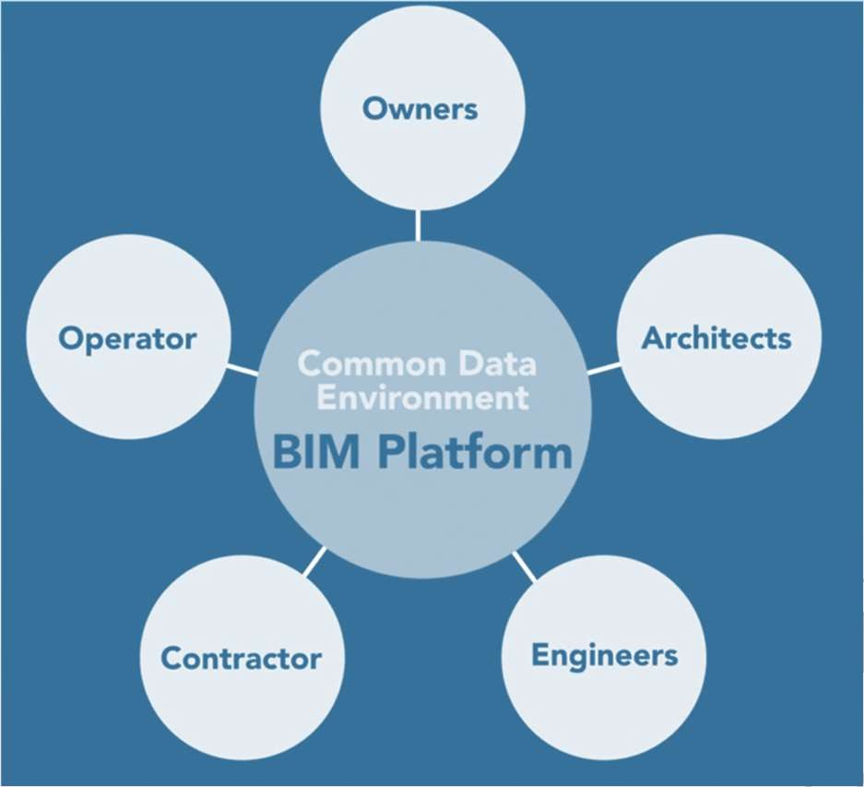
CDE
Common Data Environment (CDE) is not about the software only. It is about the workflow
1- Define states of the information: Work in Progress, shared, published, and archived.
2- Classify the files by disciplines, assets, projects, authors, etc.
3- Revision numbering system, (Revision number – WIP or Shared)
4- Status codes that will reflect the suitability of the file; for review, coordination, information, etc.

Slide 50
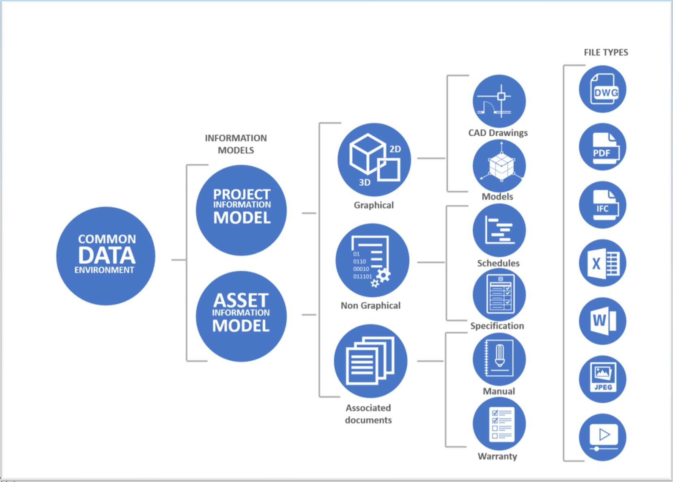
CDE

Slide 51
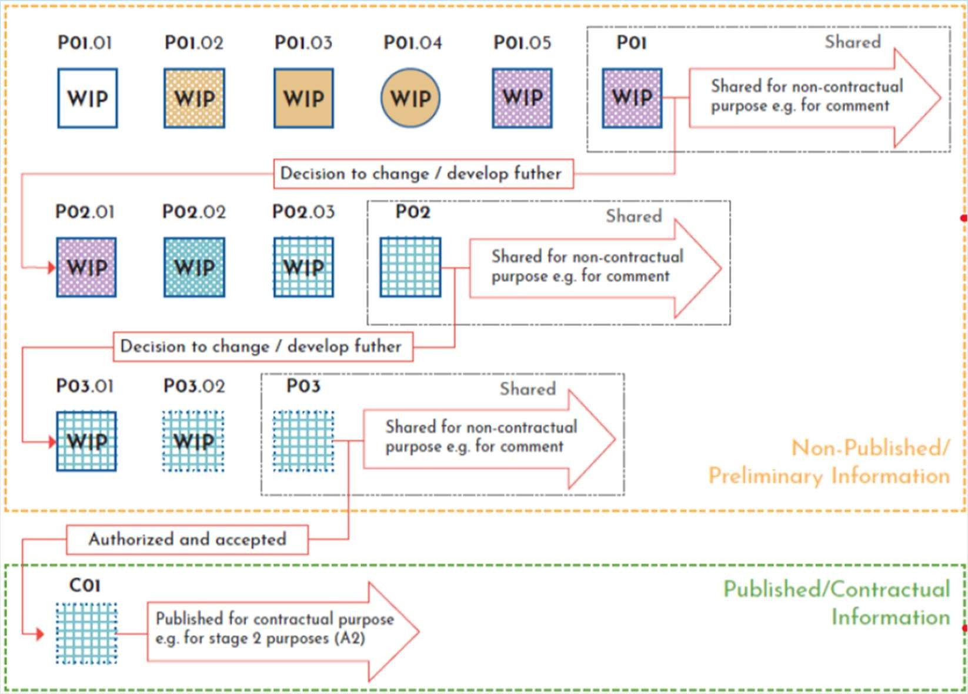
CDE

Slide 52
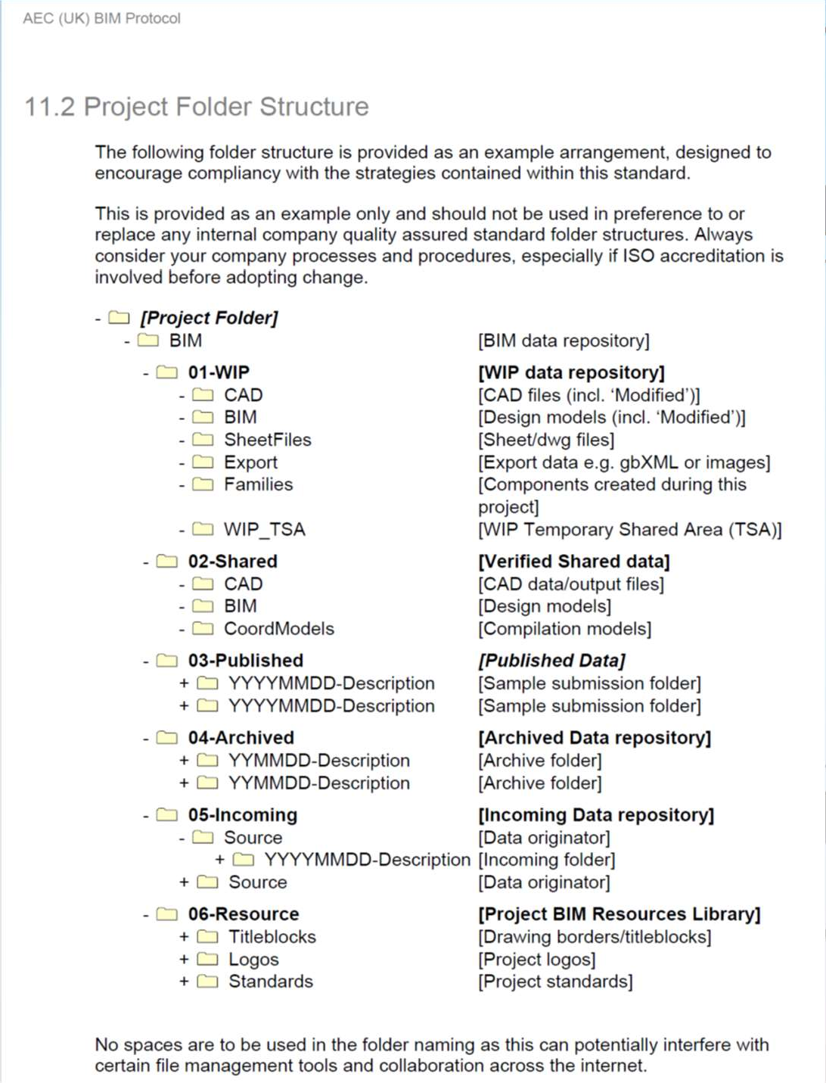
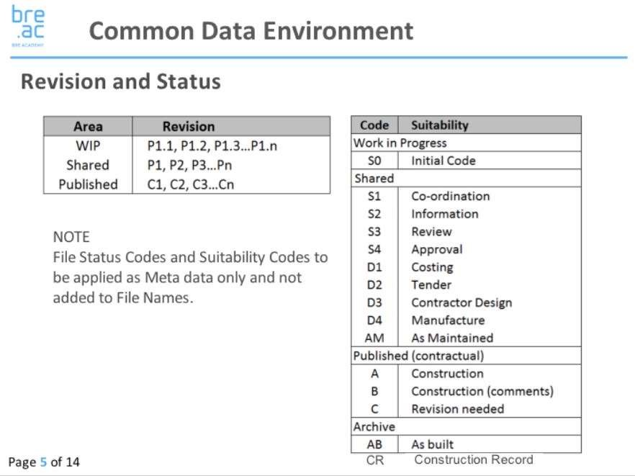
CDE

Slide 53

BIM STANDARDS

Slide 54
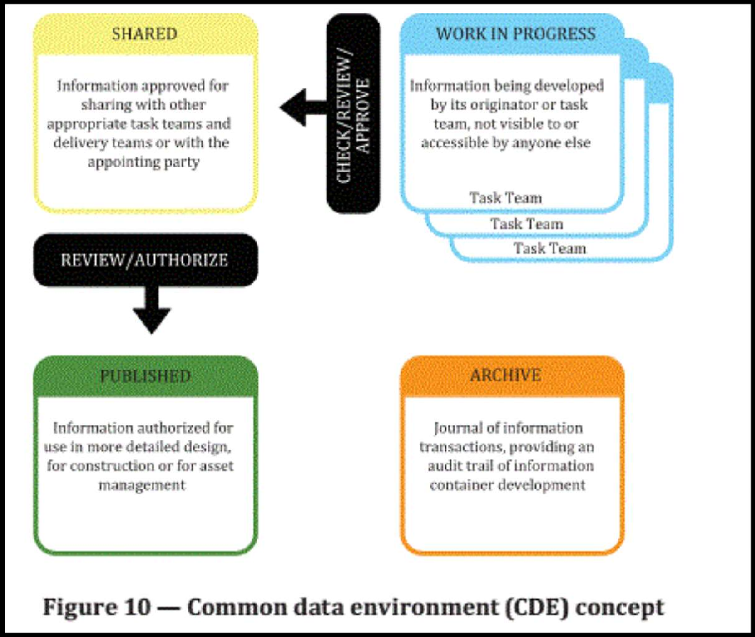
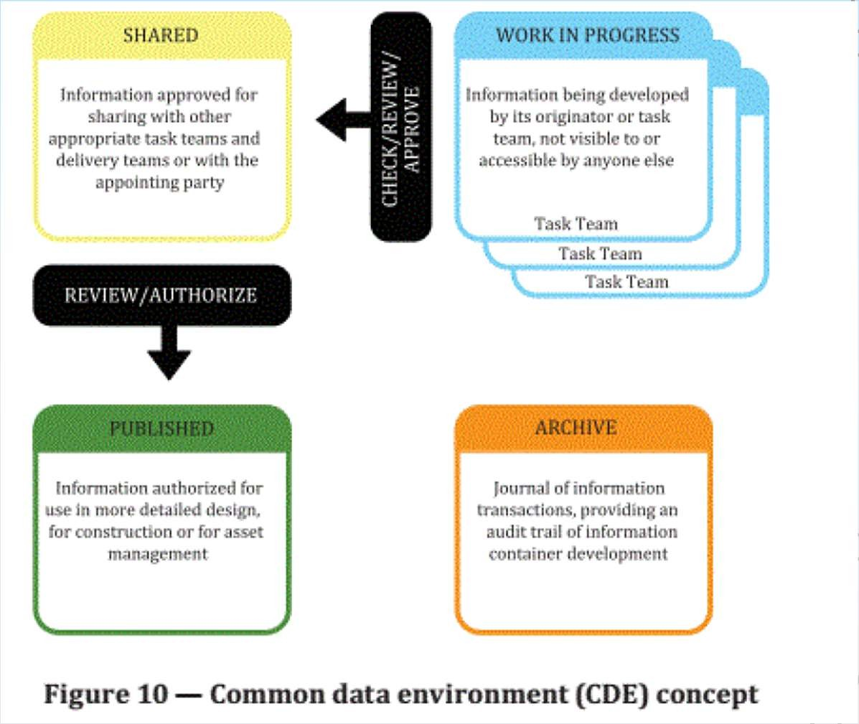
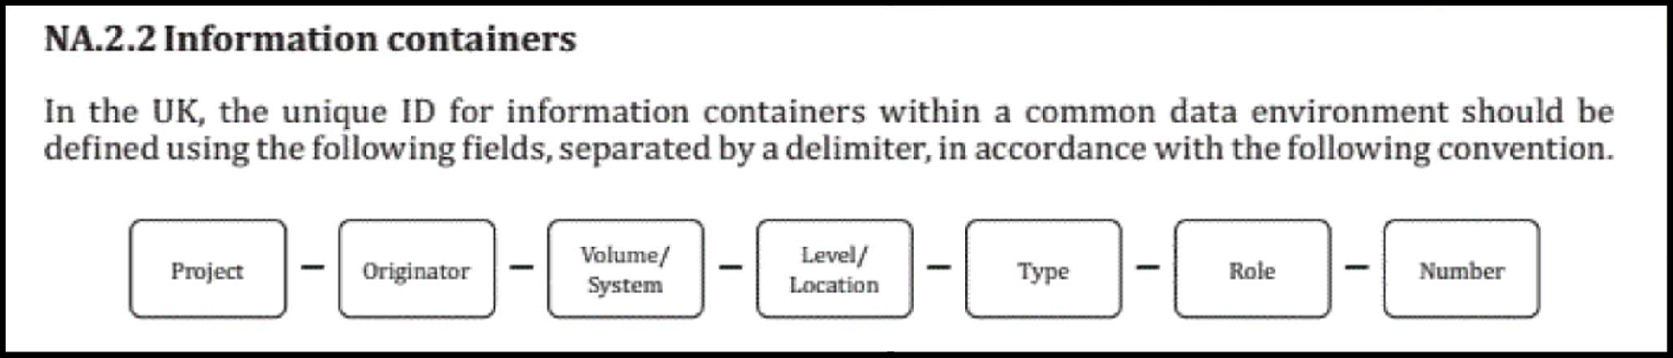
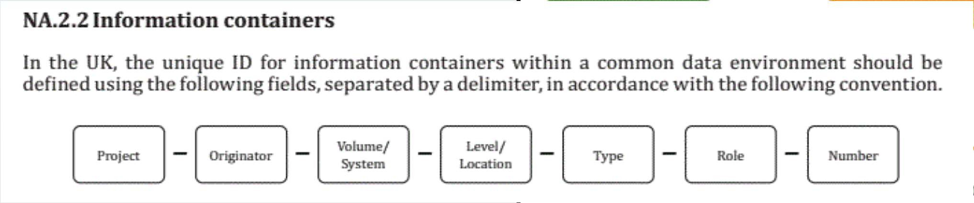
BIM STANDARDS
ISO 19650
https://bimportal.scottishfuturestrust.org.uk/level1/stage/8/task/47

Slide 55

OPEN BIM
Open BIM is a universal approach to the collaborative design, realization, and operation of buildings based on open standards and workflows. (non- proprietary)
It is an initiative of several leading software vendors using the open building SMART Data Model.

Slide 56
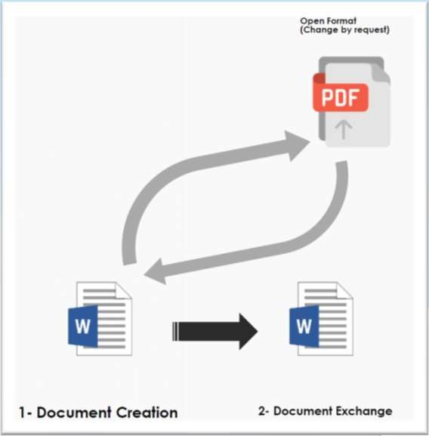
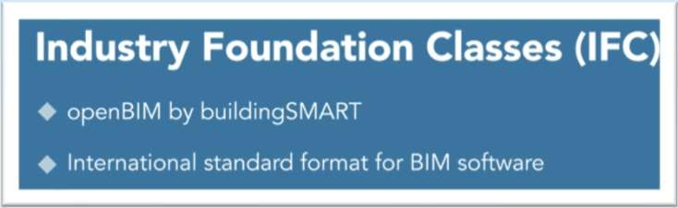
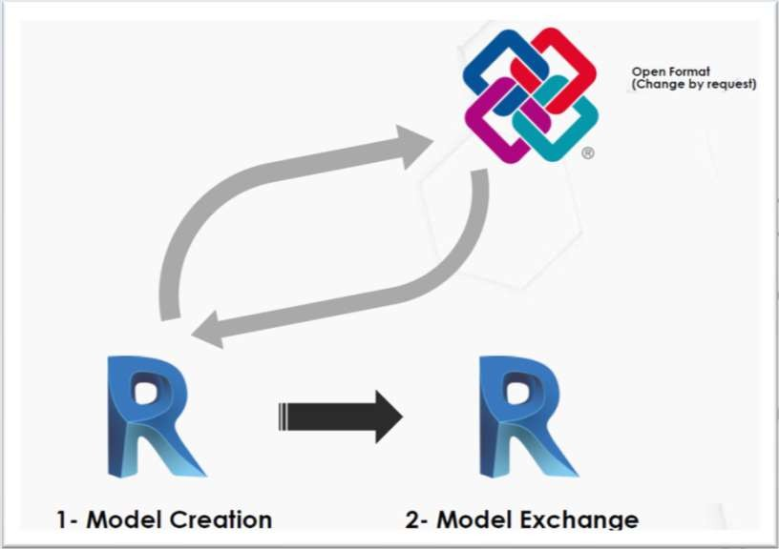
OPEN BIM
IFC
Not Issued for Construction ☺
Industry Foundation Class
Open BIM
Not to be edited
Similar to export to DXF

Slide 57
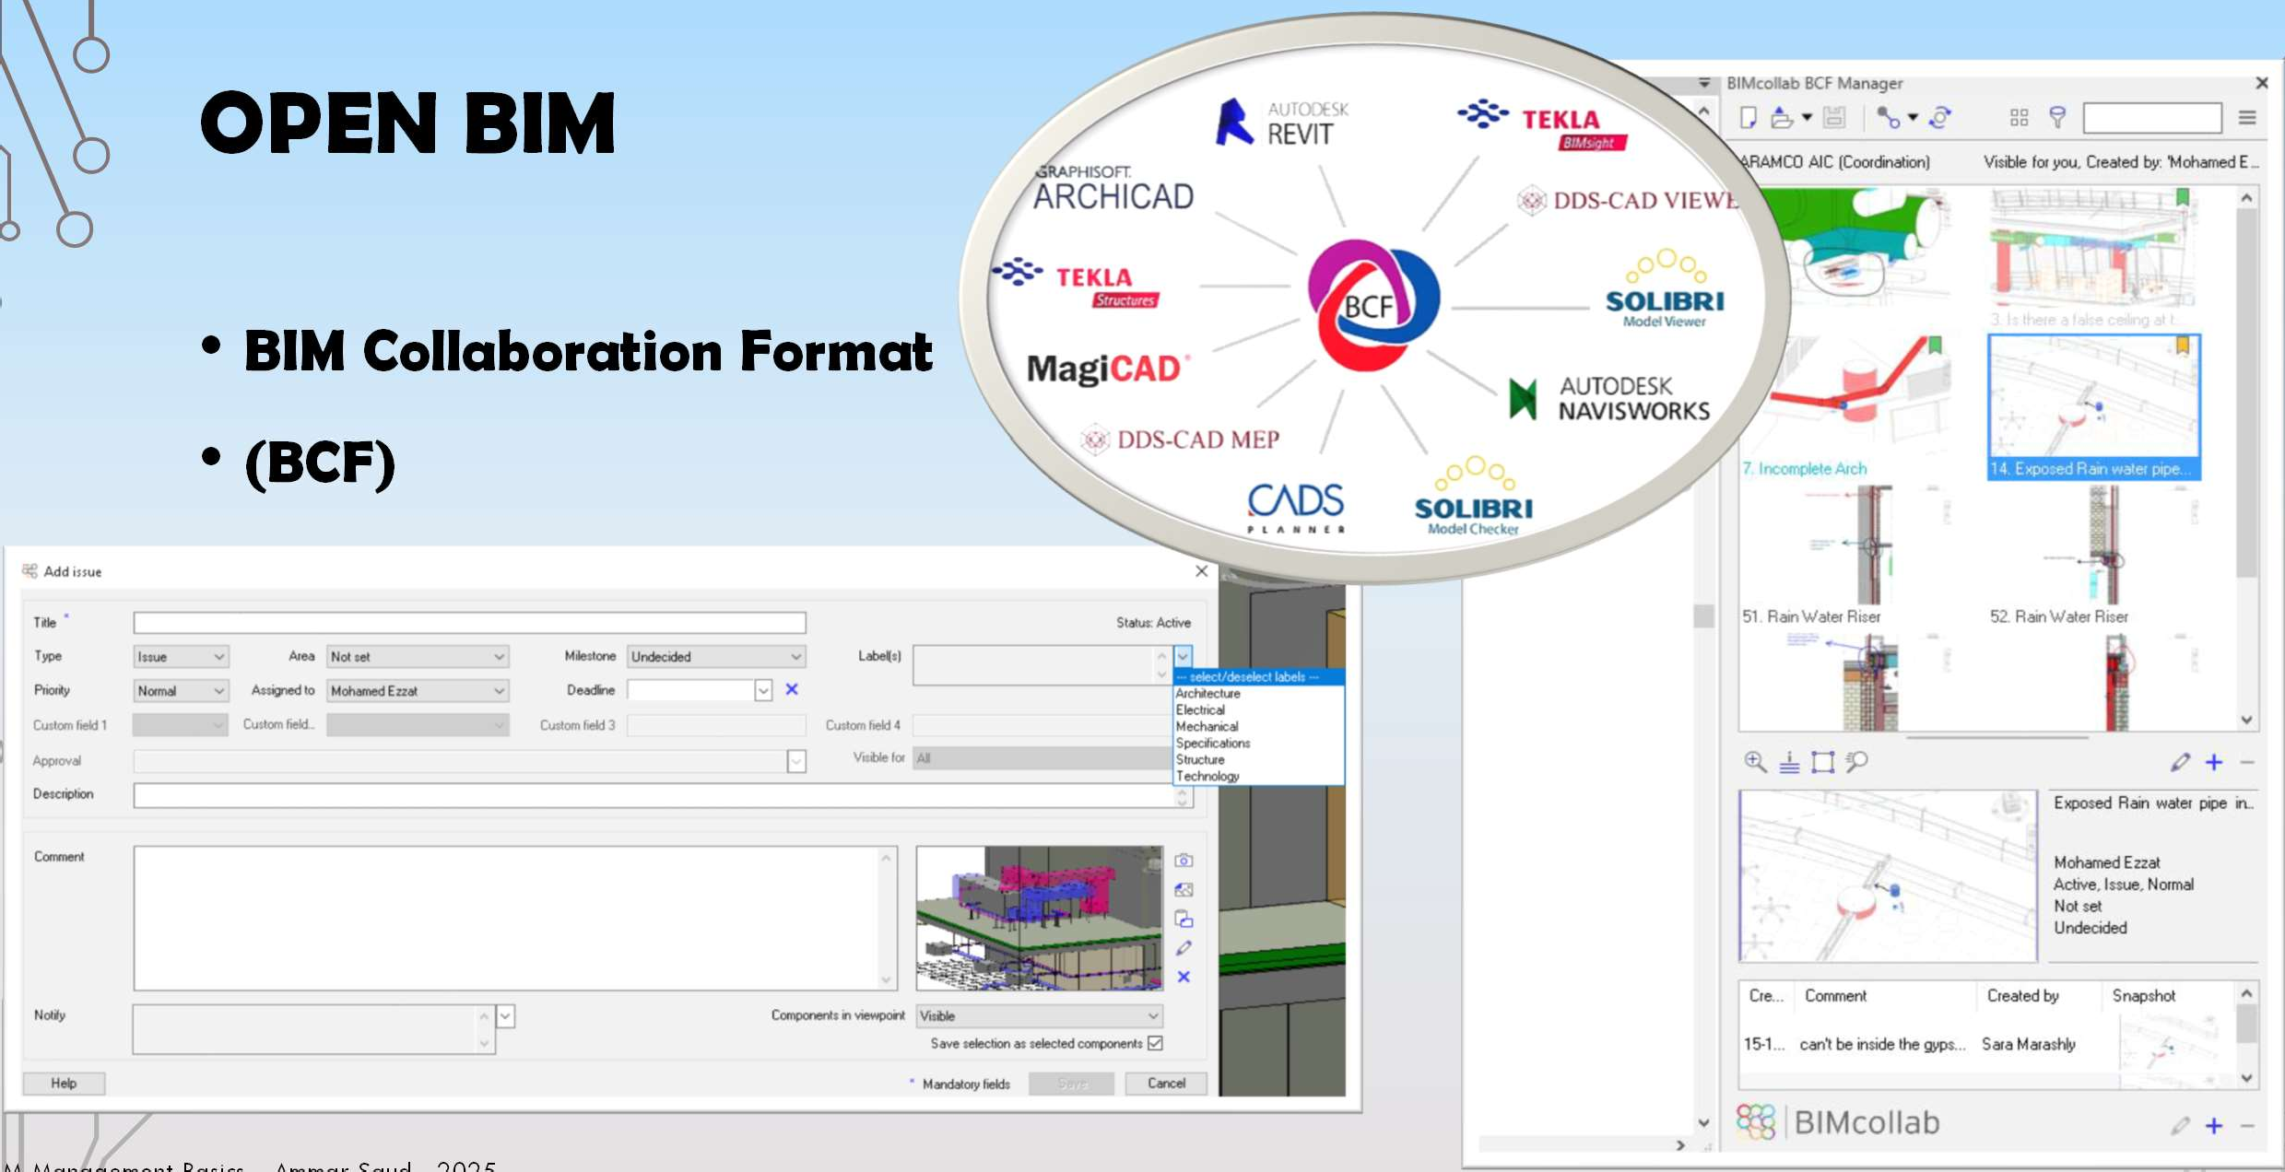
OPEN BIM
BIM Collaboration Format
(BCF)

Slide 58

COBIE
CONSTRUCTION OPERATIONS BUILDING INFORMATION EXCHANGE
Project example explains it
Some clients require specific information documented as Asset Information Requirements (AIR)
COBie eBook: https://resources.prairieskyconsulting.com
/dorm-02/index.html

Slide 59

COBIE
CONSTRUCTION OPERATIONS BUILDING INFORMATION EXCHANGE

Slide 60

COBIE
CONSTRUCTION OPERATIONS BUILDING INFORMATION EXCHANGE
Type Example

Slide 61

COBIE
CONSTRUCTION OPERATIONS BUILDING INFORMATION EXCHANGE
Attached Documents such as Warranties

Slide 62

COBIE
CONSTRUCTION OPERATIONS BUILDING INFORMATION EXCHANGE
Components show where the type is installed in the whole project

Slide 63

قائد نمذجة معلومات البناء
BIM Leader Diploma
شكراً لإصغائكم
Thank you !

